Slide 2
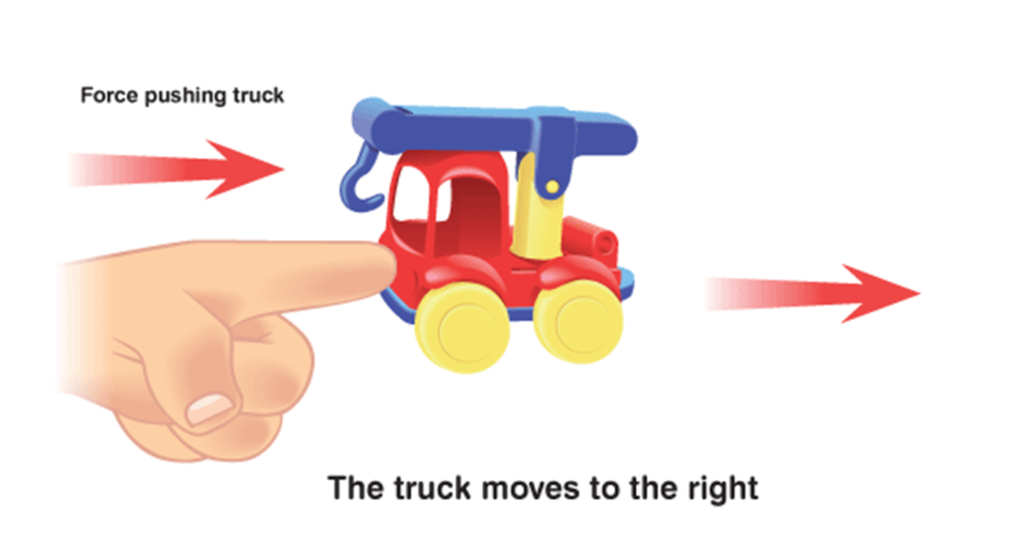
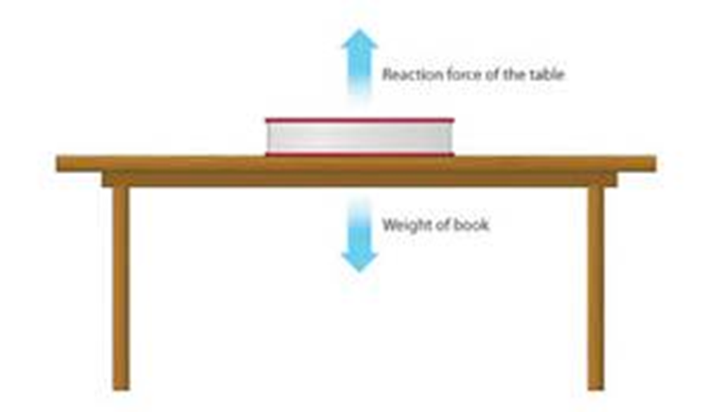
NET FORCES
the sum of all forces acting on an object

Slide 3
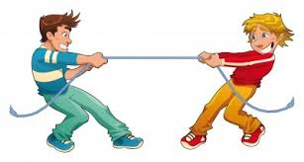
Balanced Forces (acceleration = 0) ΝετForce = 0

Slide 4
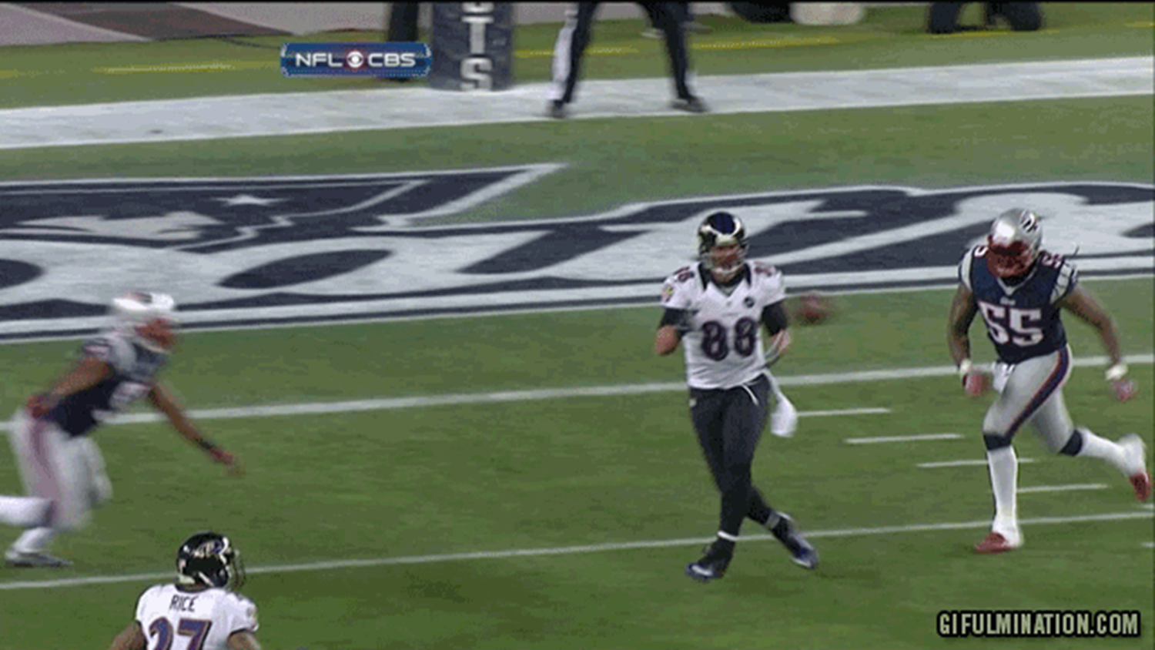
Unbalanced Forces there is acceleration ΝετForce = ???

Slide 5
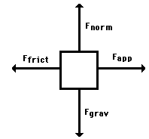
Adding momentum and forces!!! We use Free Body Diagrams
Free-body diagrams are used to show the relative magnitude and direction of all forces acting on an object.

Slide 6
Problem 1
A book is at rest on a table top. Diagram the forces acting on the book.

Slide 7
Problem 1
In this diagram, there are normal and gravitational forces on the book.

Slide 8
Problem 2
A flying squirrel is gliding (no wing flaps) from a tree to the ground at constant velocity. Consider air resistance. A free body diagram for this situation looks like…

Slide 9
Gravity pulls down on the squirrel while air resistance keeps the squirrel in the air for a while.

Slide 10
Problem3
A rightward force is applied to a book in order to move it across a desk. Consider frictional forces. Neglect air resistance. Construct a free-body diagram. Let’s see what this one looks like.

Slide 11
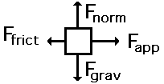
Note the applied force arrow pointing to the right. Notice how friction force points in the opposite direction. Finally, there is still gravity and normal forces involved.

Slide 12
Independent Practice 4mins
A skydiver is descending with a constant velocity. Consider air resistance. Draw a free-body diagram.
A man drags a sled across loosely packed snow with a rightward acceleration. Draw a free-body diagram.
A football is moving upwards toward its peak after having been booted by the punter. Draw a free-body diagram.

Slide 13
Net Force
Now let’s take a look at what happens when unbalanced forces do not become completely balanced (or cancelled) by other individual forces.
An unbalanced forces exists when the vertical and horizontal forces do not cancel each other out.

Slide 14
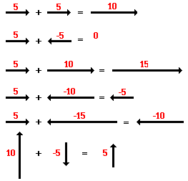
Another way to look at balances and unbalanced forces

Slide 15
Practice Finding the Net Force
Net Force:
__________
__________
0 N
No direction
Hint: Make sure to have a magnitude and a direction…

Slide 16
Practice Finding the Net Force
Net Force:
__________
__________
5 N
Left

Slide 17
Practice Finding the Net Force
Net Force:
__________
__________
0 N
No direction

Slide 18
Practice Finding the Net Force
Net Force:
__________
__________
15 N
Up

